Slide 1
Chapter 3
Supply and Demand
© 2019 McGraw-Hill Education. All rights reserved. Authorized only for instructor use in the classroom. No reproduction or distribution without the prior written consent of McGraw-Hill Education.

Slide 2
Learning Objectives
Describe how the demand and supply curves summarize the behavior of buyers and sellers in the marketplace.
Discuss how the supply and demand curves interact to determine equilibrium price and quantity.
Illustrate how shifts in supply and demand curves cause prices and quantities to change
Explain and apply the Efficiency Principle and the Equilibrium Principle (also called the “No-Cash-on-the-Table Principle”).

Slide 3
What, How, and for Whom?
Every society answers three basic questions
WHAT | Which goods will be produced? How much of each?
HOW | Which technology? Which resources are used?
FOR WHOM | How are outputs distributed? Need? Income?

Slide 4
Central Planning versus The Market
Central Planning
Decisions by individuals or small groups
Agrarian societies
Government programs
Sets prices and goals for the group
Individual influence is limited
The Market
Buyers and sellers signal wants and costs
Resources and goods are allocated accordingly
Interaction of supply and demand answer the three basic questions
Mixed economies use both the market and central planning

Slide 5
Buyers and Sellers in the Market
The market for any good consists of all the buyers and sellers of the good
Buyers and sellers have different motivations
Buyers want to benefit from the good
Sellers want to make a profit
Market price balances two forces
Value buyers derive from the good
Cost to produce the good

Slide 6
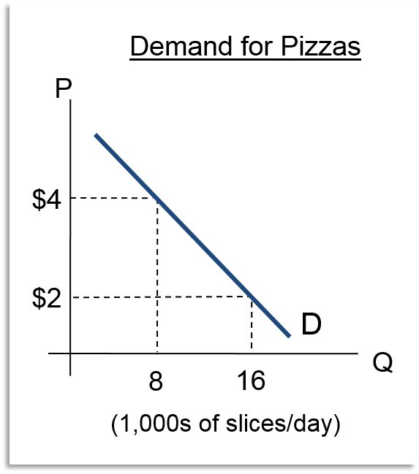
Demand
A demand curve illustrates the quantity buyers would purchase at each possible price
Demand curves have a negative slope
Consumers buy less at higher prices
Consumers buy more at lower prices

Slide 7
Demand Slopes Downward
Buyers value goods differently
The buyer’s reservation price is the highest price an individual is willing to pay for a good
Demand reflects the entire market, not one consumer
Lower prices bring more buyers into the market
Lower prices cause existing buyers to buy more

Slide 8
Income and Substitution Effects
Buyers buy more at lower prices and buy less at higher prices
What happens when price goes up?
The substitution effect: Buyers switch to substitutes when price goes up
The income effect: Buyers' overall purchasing power goes down

Slide 9
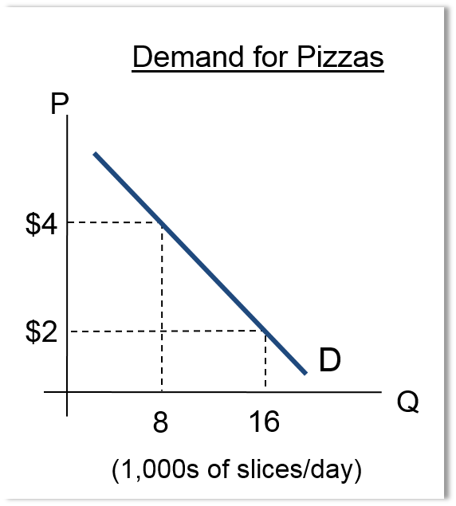
Interpreting the Demand Curve 1
Horizontal interpretation of demand:
Given price, how much will buyers buy?
At a price of $4, the quantity demanded is 8,000 slices/day.

Slide 10
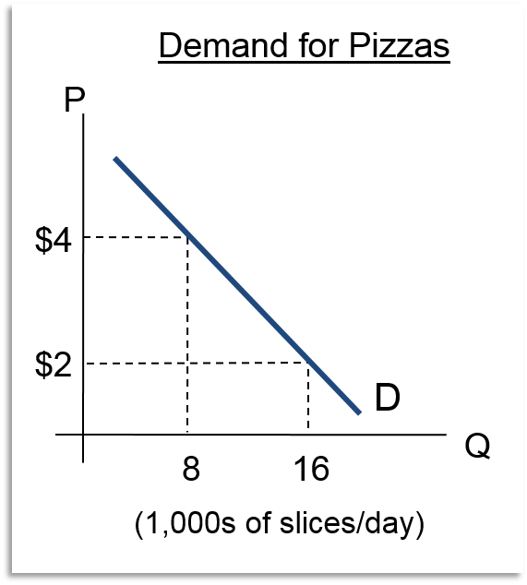
Interpreting the Demand Curve 2
Vertical interpretation of demand:
Given the quantity to be sold, what price is the marginal consumer willing to pay?
The marginal consumer is willing to pay $4 per slice for the 8,000th slice sold in the market.

Slide 11
The Supply Curve
The supply curve illustrates the quantity of a good that sellers are willing to offer at each price
If the price is less than opportunity cost, offer more
Opportunity cost differs among sellers due to:
Technology
Skills
Different costs such as rent
Expectations
The Low-Hanging Fruit Principle explains the upward sloping supply curve
The seller’s reservation price is the lowest price the seller would be willing to sell for
Equal to marginal cost

Slide 12
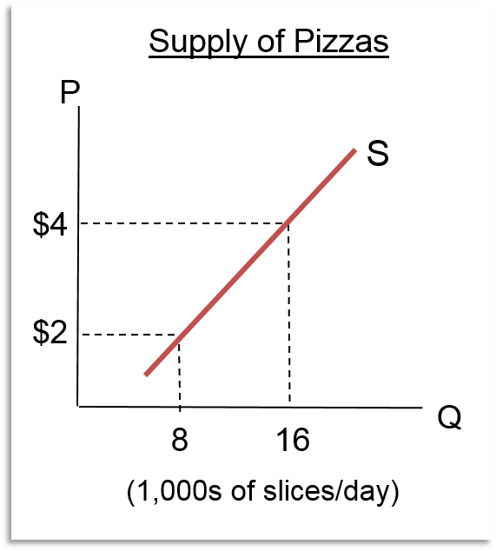
Interpreting the Supply Curve 1
Horizontal interpretation of supply:
Given price, how much will suppliers offer?
At a price of $2, suppliers are willing to sell 8,000 slices/day.

Slide 13
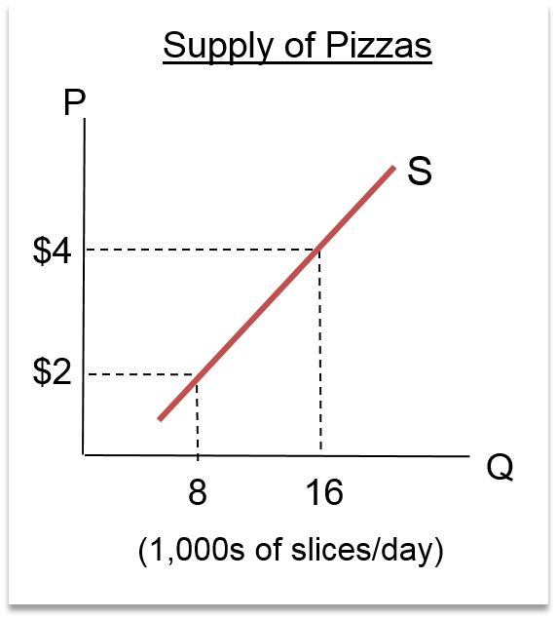
Interpreting the Supply Curve 2
Vertical interpretation of supply:
Given the quantity to be sold, what is the opportunity cost of the marginal seller?
The marginal cost of producing the 8,000th slice is $2.

Slide 14
Market Equilibrium 1
A system is in equilibrium when there is no tendency for it to change
The equilibrium price is the price at which the supply and demand curves intersect
The equilibrium quantity is the quantity at which the supply and demand curves intersect
The market equilibrium occurs when all buyers and sellers are satisfied with their respective quantities at the market price
At the equilibrium price, quantity supplied equals quantity demanded

Slide 15
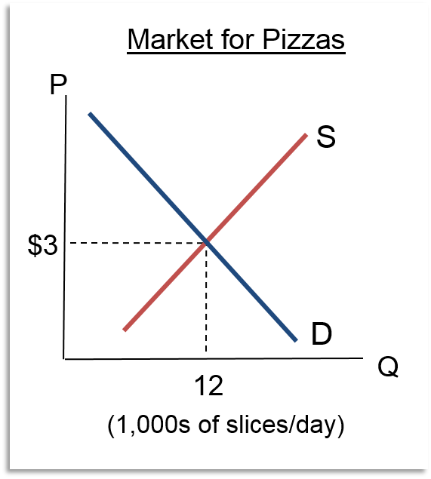
Market Equilibrium 2
Quantity supplied equals quantity demanded AND
Price is on supply and demand curves
No tendency to change P or Q
Buyers are on their demand curve
Sellers are on their supply curve

Slide 16
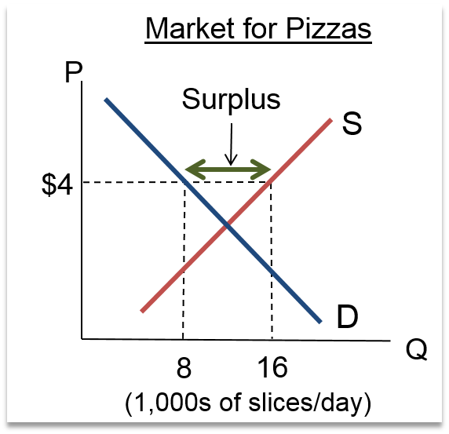
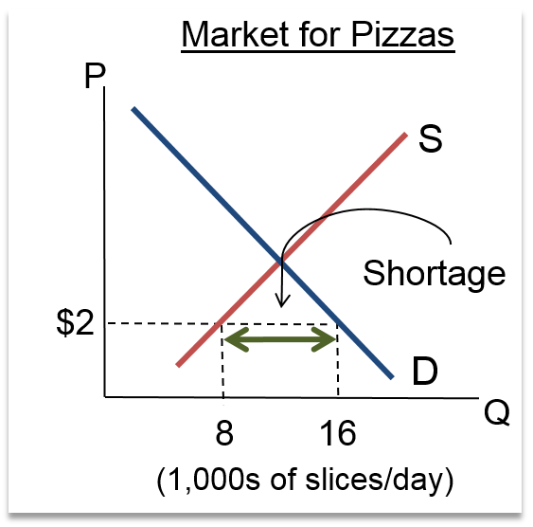
Excess Supply and Excess Demand
Excess Supply
At $4, 16,000 slices supplied and 8,000 slices demanded
Excess Demand
At $2, 8,000 slices supplied 16,000 slices demanded

Slide 17
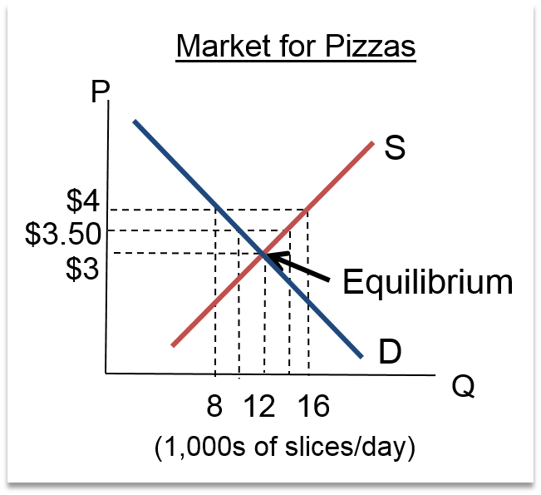
Incentive Principle: Excess Supply at $4
Each supplier has an incentive to decrease the price in order to sell more
Lower prices decrease the surplus
As price decreases:
the quantity offered for sale decreases along the supply curve
the quantity demanded increases along the demand curve

Slide 18
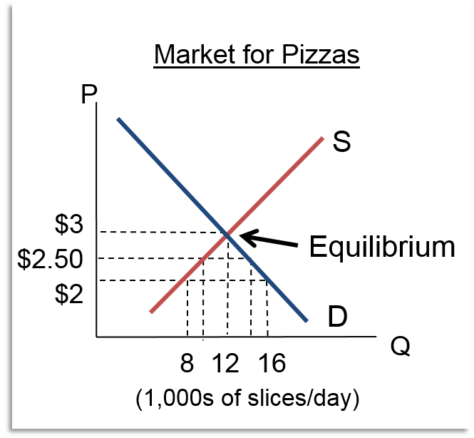
Incentive Principle: Excess Demand at $2
Each supplier has an incentive to increase the price in order to sell more
Higher prices decrease the shortage
As price increases
the quantity offered for sale increases along the supply curve
As price increases, the quantity demanded decreases along the demand curve.

Slide 19
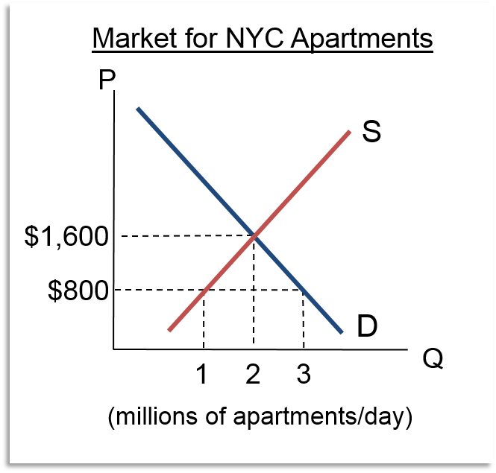
Rent Controls Are Price Ceilings
A price ceiling is a maximum allowable price, set by law
Rent controls set a maximum price that can be charged for a given apartment
If the controlled price is below equilibrium, then:
Quantity demanded increases
Quantity supplied decreases
A shortage results

Slide 20
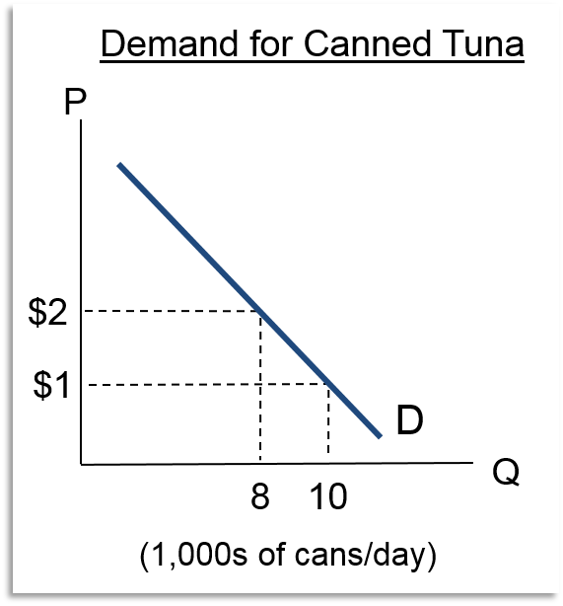
Movement along the Demand Curve
When price goes up, quantity demanded goes down
When price goes down, buyers move to a new, higher quantity demanded
A change in quantity demanded results from a change in the price of a good.

Slide 21
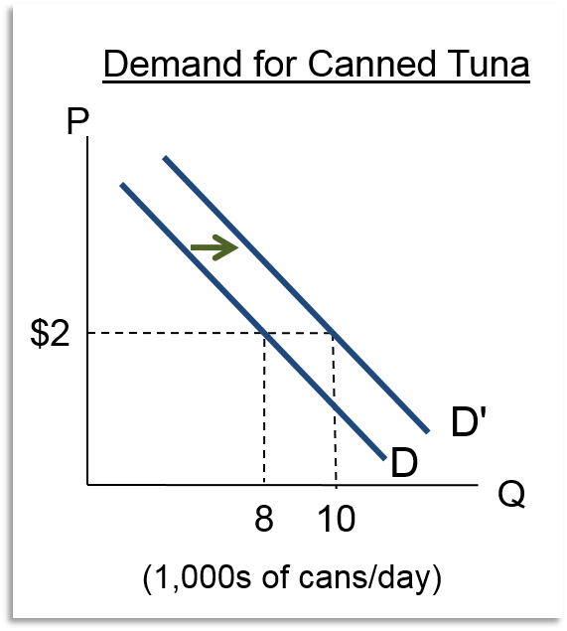
Shift in Demand
If buyers are willing to buy more at each price, then demand has increased
Move the entire demand curve to the right
Change in demand
If buyers are willing to buy less at each price, then demand has decreased

Slide 22
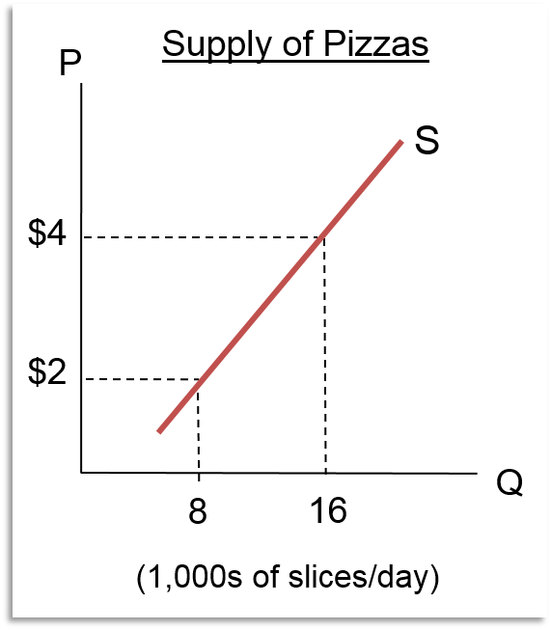
Movement Along the Supply Curve
When price goes up, quantity supplied goes up
When price goes up, sellers move to a new, higher quantity supplied
A change in quantity supplied results from a change in the price of a good.

Slide 23
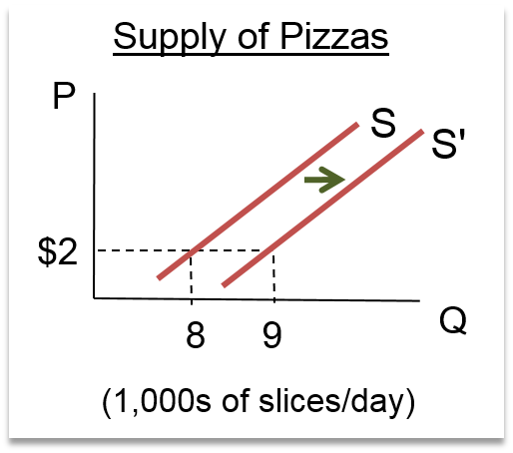
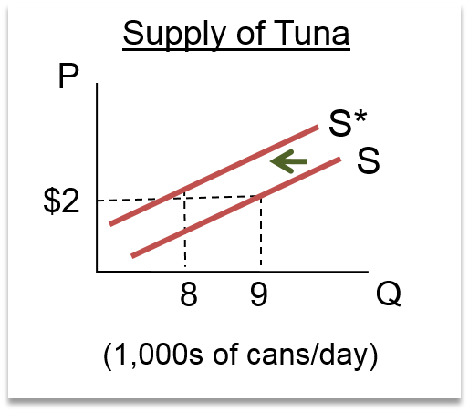
Shift in Supply
Supply increases when sellers are willing to offer more for sale at each possible price
Moves the entire supply curve to the right
Supply decreases when sellers are willing to offer less for sale at each possible price
Moves the entire supply curve to the left

Slide 24
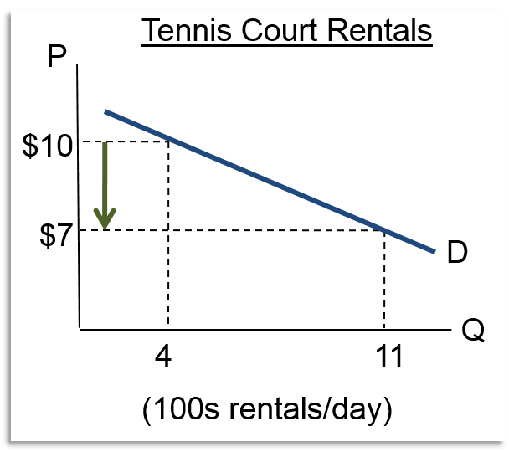
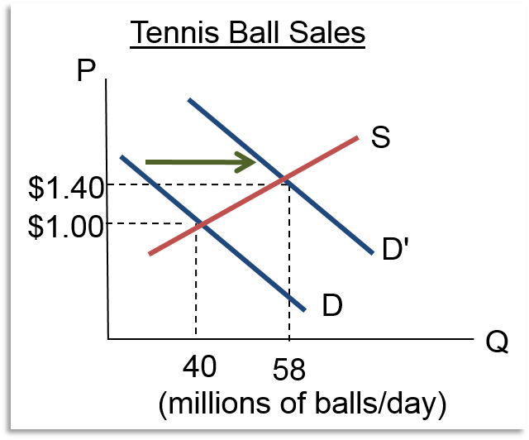
Tennis Market
If the price of renting for tennis court decreases, demand for tennis balls increases
Tennis courts and tennis balls are complements

Slide 25
Causes of Shifts in Demand
Price of complementary goods
Tennis courts and tennis balls
Price of substitute goods
E-mail and snail mail are substitutes
Income: normal or inferior goods?
Preferences
Dinosaur toys after Jurassic Park movie
Number of buyers in the market
Expectations about the future
Price changes never cause a shift in demand

Slide 26
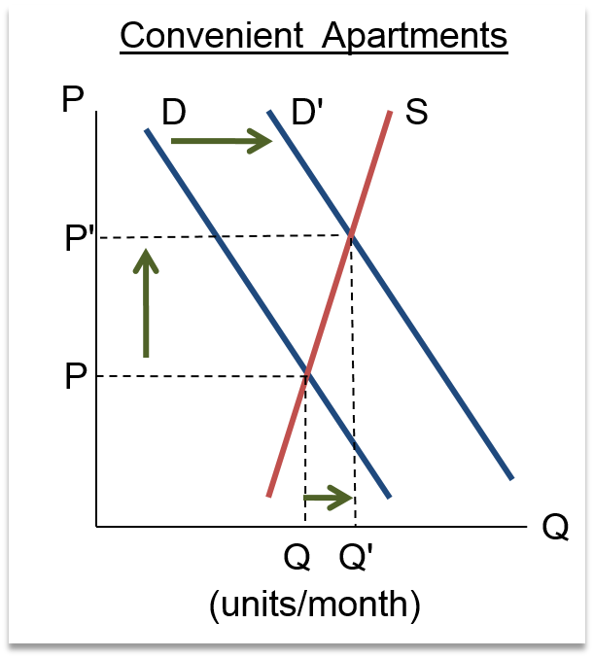
Apartments Near DC Metro
If government wages rise, demand for apartments near Metro stations increases
Demand increases
Price increases
Quantity increases
Demand for a normal good increases when income increases
Demand for an inferior good increases when income decreases

Slide 27
Causes of Shifts in Supply
A change in the price of an input
Fiberglass for skateboards, construction wages
A change in technology
Desktop publishing and term papers
Internet distribution of products (e-commerce)
Weather (agricultural commodities and outdoor entertainment)
Number of sellers in the market
Expectation of future price changes
Price changes never cause a shift in supply

Slide 28
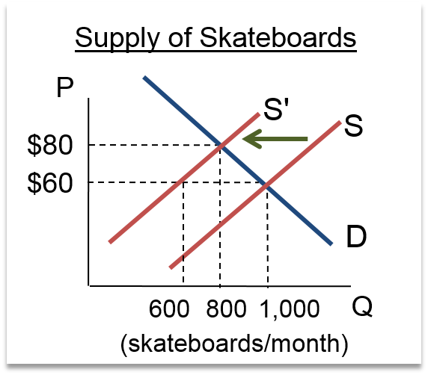
Shift in Supply: Skateboards
Costs of production affect the supply of a product
Cost of fiberglass for skateboards increases
Supply decreases
With no change in demand, the price of skateboards increases to $80 and quantity decreases to 800
Remember – don’t think “price went up so demand should shift left.” Price changes never cause a shift in demand.

Slide 29
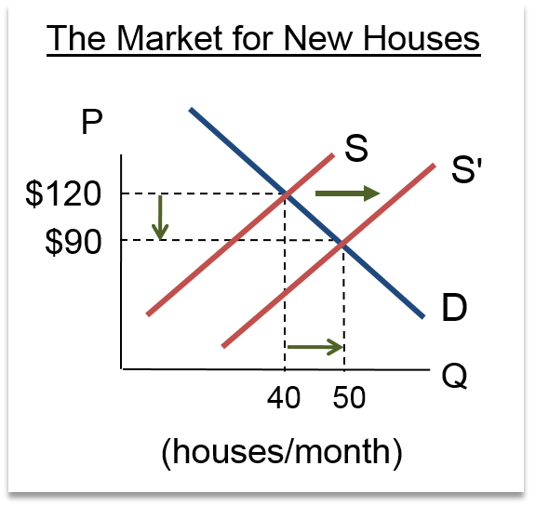
Shift in Supply: Home Construction
Cost of labor used to produce houses decreases
Supply increases
Demand is constant
The price of houses decreases to $90,000 per house
Quantity increases to 50

Slide 30
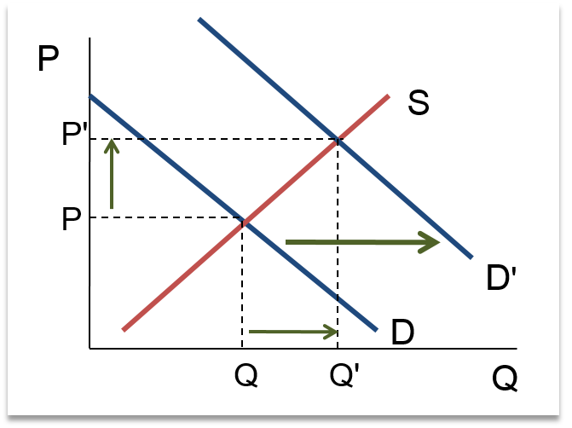
Supply and Demand Shifts: Four Rules 1
An increase in demand will lead to an increase in both equilibrium price and quantity

Slide 31
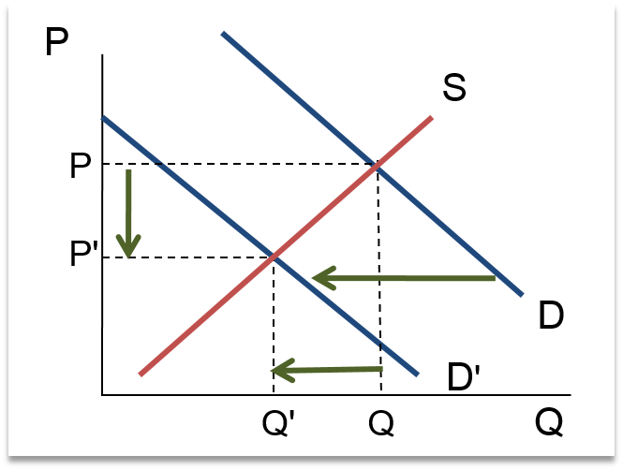
Supply and Demand Shifts: Four Rules 2
An decrease in demand will lead to a decrease in both equilibrium price and quantity

Slide 32
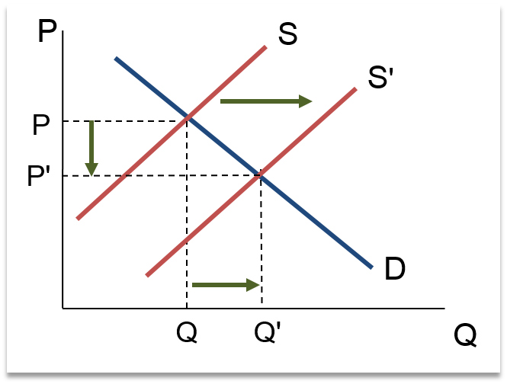
Supply and Demand Shifts: Four Rules 3
An increase in supply will lead to a decrease in the equilibrium price and an increase in the equilibrium quantity.

Slide 33
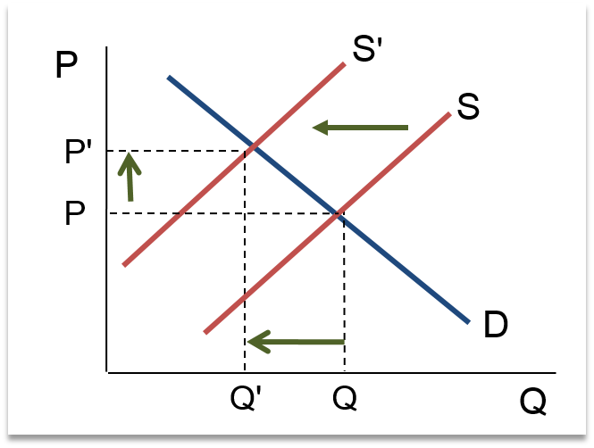
Supply and Demand Shifts: Four Rules 4
An decrease in supply will lead to an increase in the equilibrium price and a decrease in the equilibrium quantity.

Slide 34
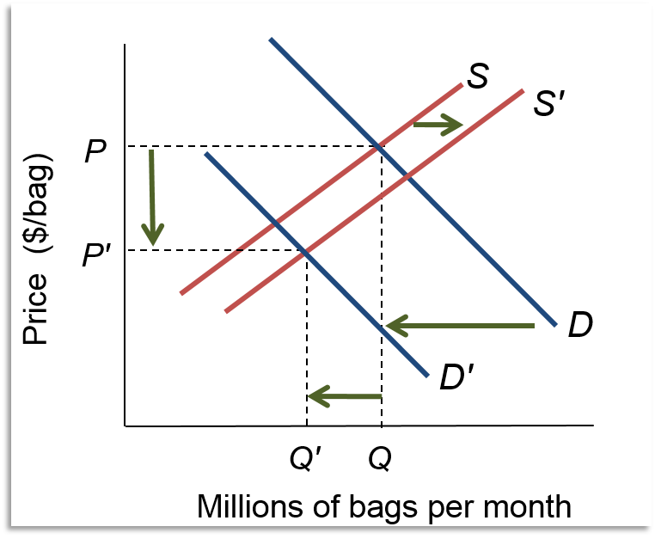
Supply and Demand Both Change: Tortilla Chips 1

Slide 35
Supply and Demand Both Change: Tortilla Chips 2
 | Supply
Demand | Increases | Decreases
Increases | P Depends Q Increases | P Increases Q Depends
Decreases | P Decreases Q Depends | P Depends Q Decreases

Slide 36
Efficiency and Equilibrium
Markets communicate information effectively
Value buyers place on the product
Opportunity cost of producing the product
Markets maximize the difference between benefits and costs (economic surplus)
Market outcomes are the best provided that
The market is in equilibrium AND
No costs or benefits are shared with the public

Slide 37
Cash on the Table
Buyer's surplus: buyer's reservation price minus the market price
Seller's surplus: market price minus the seller's reservation price
Total surplus = buyer's surplus + seller's surplus
Total surplus is buyer's reservation price − seller's reservation price
No cash on the table when surplus is maximized
No opportunity to gain from additional sales or purchases

Slide 38
Efficiency Principle
The socially optimal quantity maximizes total surplus for the economy from producing and selling a good
Economic efficiency – all goods are produced at their socially optimal level
Efficiency Principle: equilibrium price and quantity are efficient if:
Sellers pay all the costs of production
Buyers receive all the benefits of their purchase
Efficiency: marginal cost equals marginal benefit
Production is efficient if total surplus is maximized

Slide 39
Smart for One, Dumb for All
Producers sometimes shift costs to others
Pollution is like getting free waste disposal services
Total marginal cost = seller's marginal cost plus marginal cost of pollution
When costs are shifted, supply is greater than socially optimal
Buyers may create benefits for others
Marginal benefit is less than the full social benefit
Vaccinations, my neighbor's landscaping
The demand for these goods is less than socially optimal

Slide 40
Equilibrium Principle
Equilibrium Principle: a market in equilibrium leaves no unexploited opportunities for individuals
BUT it may not exploit all gains achievable through collective action
Only when the seller pays the full cost of production and the buyer captures the full benefit of the good is the market outcome socially optimal
Regulation, taxes and fines, or subsidies can move the market to optimal level

Slide 41
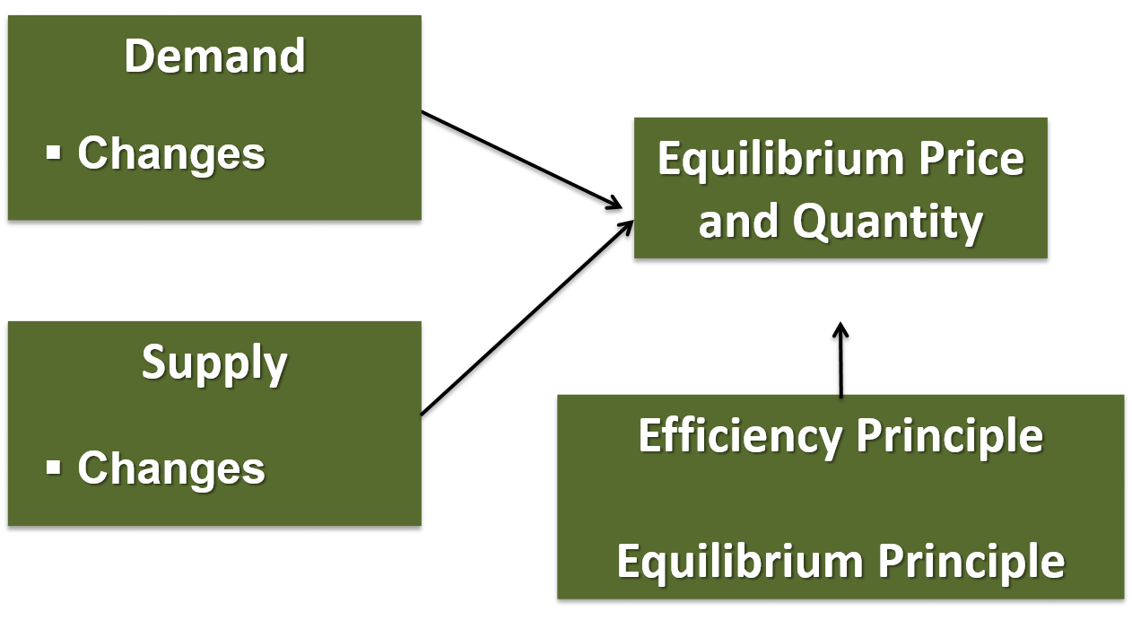
Supply and Demand

Slide 42
Chapter 3 Appendix
The Algebra of Supply and Demand

Slide 43
From Graphs to Equations …
Sample equations
is a straight-line demand curve with intercept 16 on the vertical (P) axis and a slope of −2
is a straight-line supply curve with intercept 4 and a slope of 4

Slide 44
… To Equilibrium P and Q
Equilibrium is where P and Q are the same for demand and supply
Set the two equations equal to each other (P = P) and solve for Q (Q^{s} = Q^{d} = Q*)
Use either the supply or demand curve and Q* = 2 to find price

